Slide 1
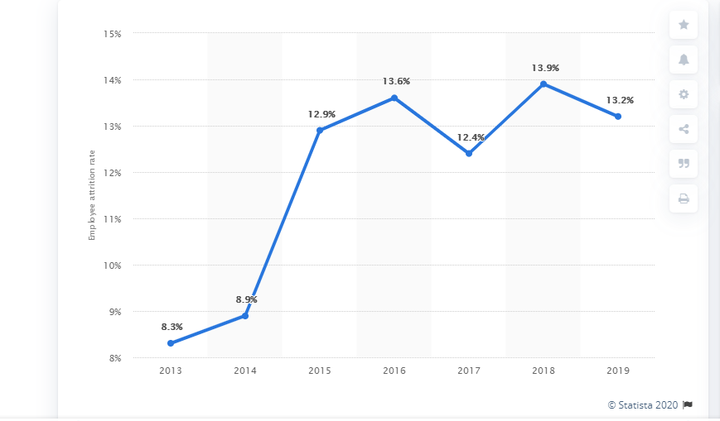
Companies using analytics to curb attrition rate are:
MASTER CARD
IBM
NIELSEN
Juniper Networks
Royal Dutch Shell
Xerox
Google
ATTRITION RATE TREND
MACHINE LEARNING
WHAT IS ATTRITION RATE?
Attrition rate is also commonly referred to as churn rate. A term often used by human resources professionals to determine a company’s ability to retain employees, attrition rate is increasingly used in the marketing world as a figure that points to the company’s ability to retain customers or to project the number of new sales necessary to maintain the status quo, accounting for customer churn or customer attrition
ATTRITION RATE
c
B
A
SUBMITTED BY :-
PRACHI GOPALANI

Slide 2
Data Description and
Classification techniques
Techniques Used
8 Columns
Independent Variables:- 7,
Dependent Variable:- 1,
Dependent Variable Type: Binary and categorical
Logistic Regression
KNN
Naïve Bayes
Decision Tree
Random Forest
Support Vector Machine
Grid Search CV
Understanding the problem statement
Predict Attrition Rate of IBM
What algorithms can be used to solve the business objective ?
ROADMAP

Slide 3
ATTRIBUTES
Independent Variables were:
Age: Age of employees
Department: Department of work
Distance from home
Education: 1-Below College; 2-College; 3-Bachelor; 4-Master; 5-Doctor;
Education Field
Environment Satisfaction: 1-Low; 2-Medium; 3-High; 4-Very High;
Job Satisfaction: 1-Low; 2-Medium; 3-High; 4-Very High;
Marital Status
Monthly Income
Num Companies Worked: Number of companies worked prior to IBM
Work Life Balance: 1-Bad; 2-Good; 3-Better; 4-Best;
Years At Company: Current years of service in IBM
Dependent Variable was:
Attrition: Employee attrition status

Slide 4
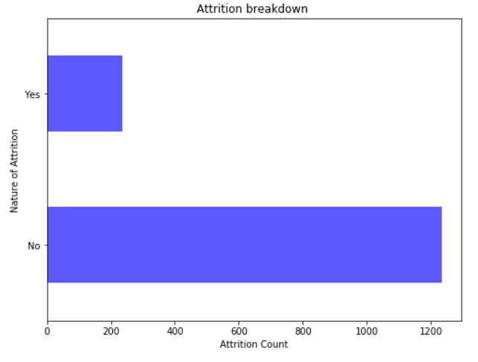
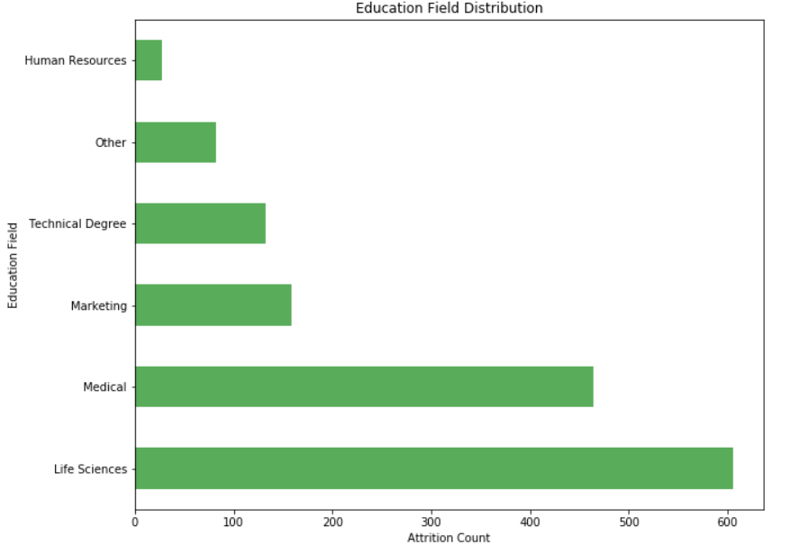
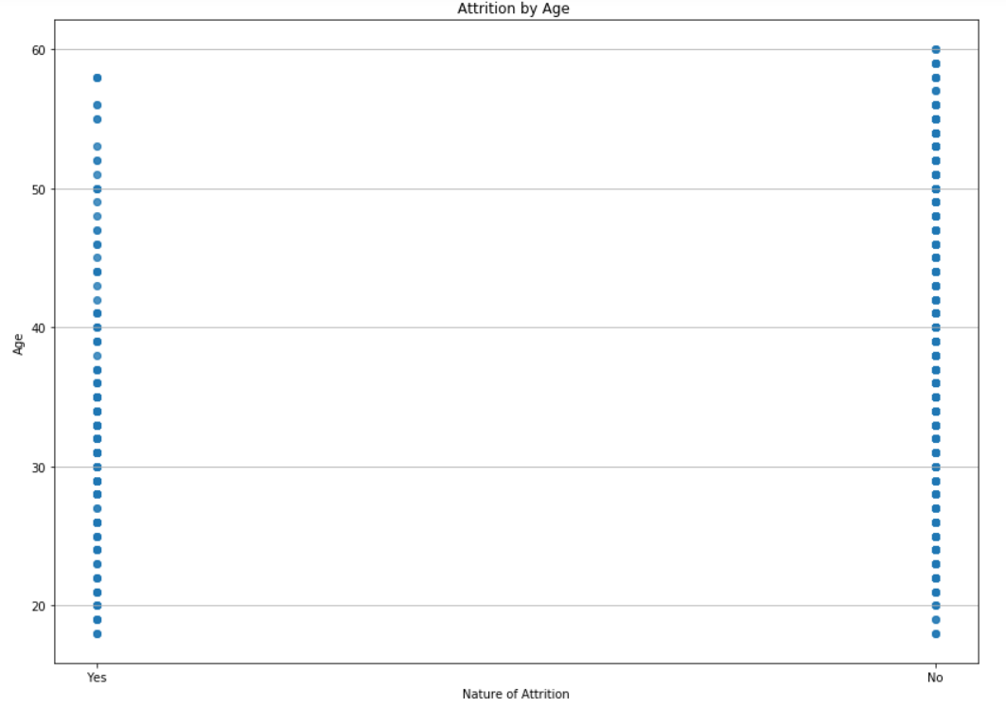
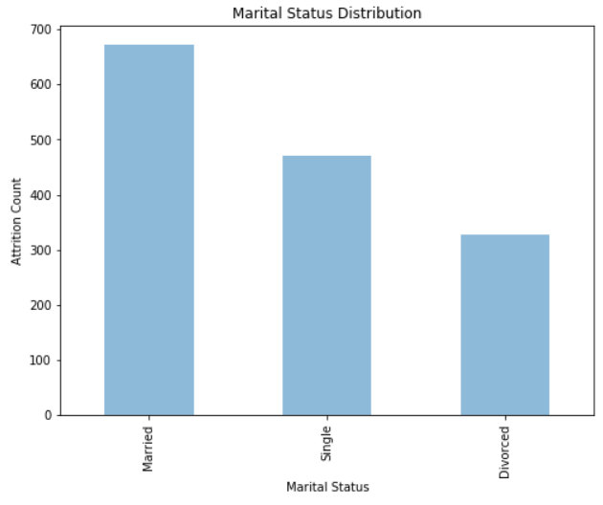
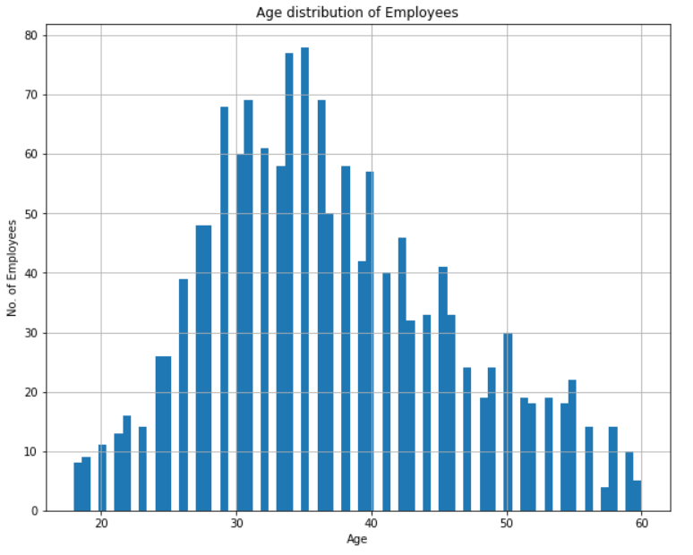
EXPLORATORY DATA ANALYSIS(EDA)
The categorical variables were: Attrition, Department, Education Field and Marital Status. Thus, it was converted into dummy variable.
Further the correlation between the variables was calculated. This was done so as to find the variables more significant in prediction of the target variable.

Slide 5
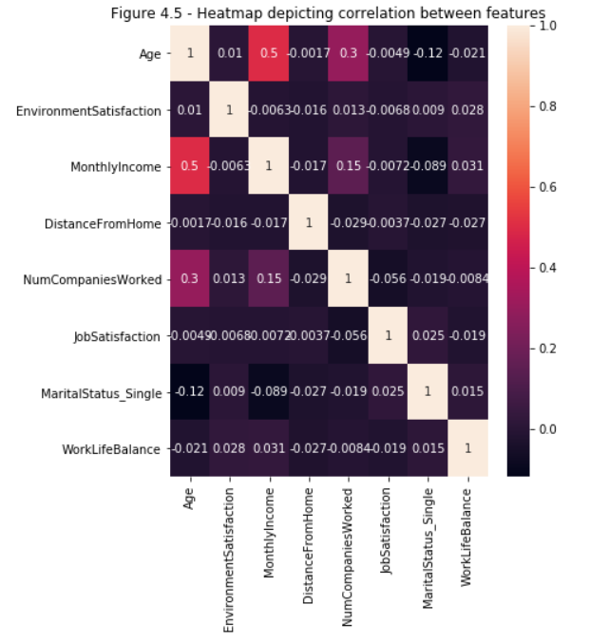
Feature Selection
Feature Selection is the process where you automatically or manually select those features which contribute most to your prediction variable or output in which you are interested in.
The variables which we have created for feature selection are :
Age
EnvironmentSatisfaction
MonthlyIncome
DistanceFromHome
NumCompaniesWorked
JobSatisfaction
MaritalStatus_Single
WorkLifeBalance

Slide 6
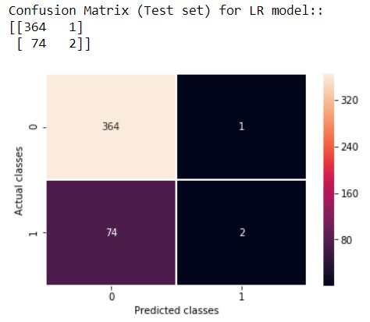
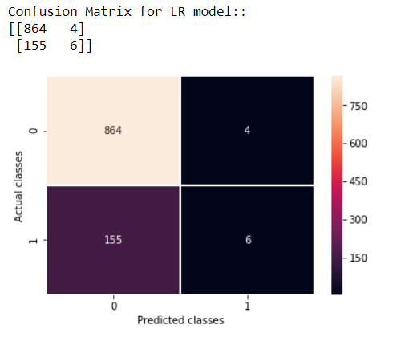
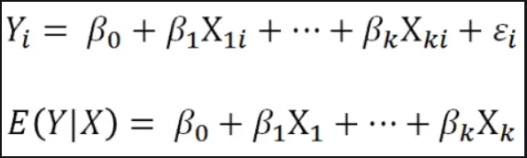
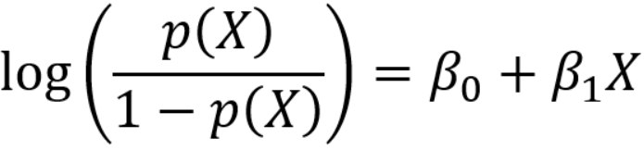

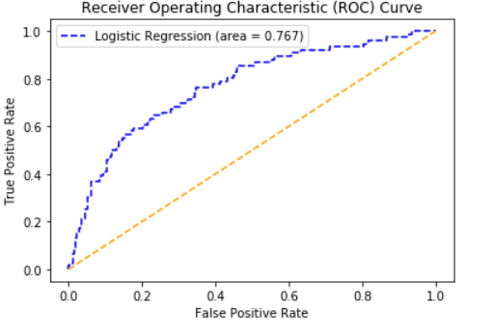
LOGISTIC REGRESSION
Logistic regression is a statistical method for predicting binary/multiple classes. The outcome or target variable is binary in nature.
Logistic Regression Equation :-
Logit Function Equation :-
TO CHECK THE PERFORMANCE (ROCR CURVE):
The threshold probability was found to be 0.6.
Sensitivity of model was about 76.7% i.e. the True positive rate.

Slide 7
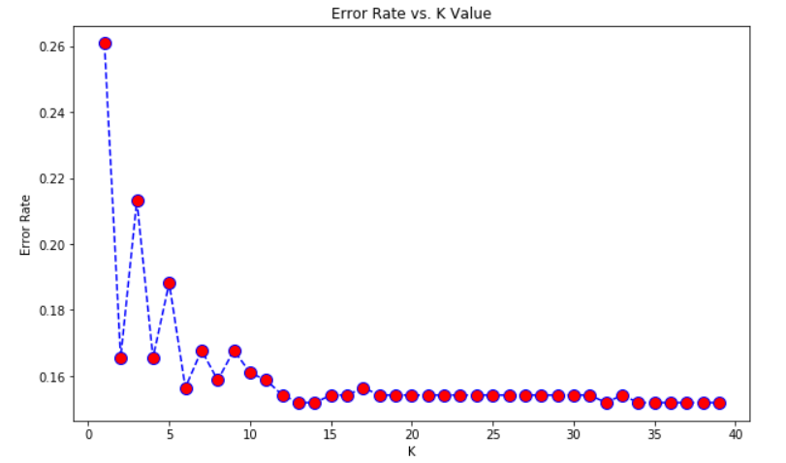
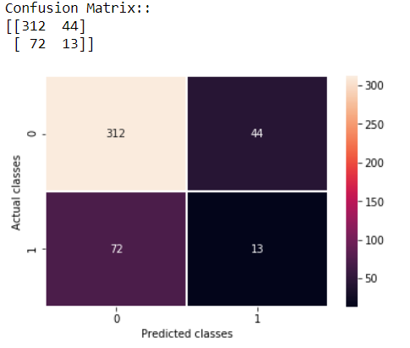
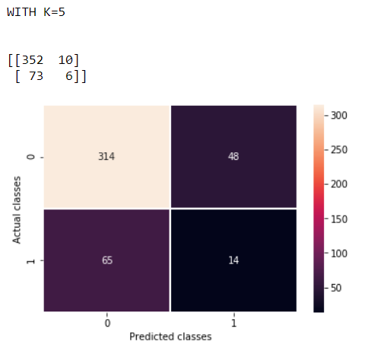
K Nearest Neighbors
KNN captures the idea of similarity (sometimes called distance, proximity, or closeness) with some mathematics calculating the distance between points on a graph.
Here we can see that after K>5 the error rate just tends to hover around 0.18-0.16.

Slide 8
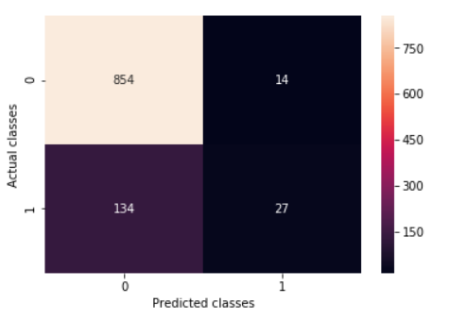
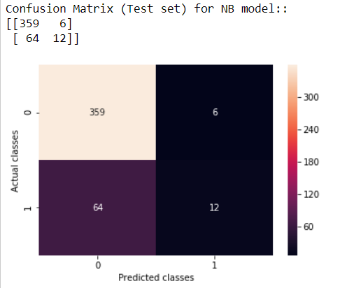
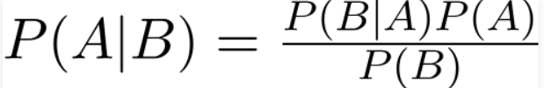
NAIVE BAYES
A classifier is a machine learning model that is used to discriminate different objects based on certain features.

Slide 9
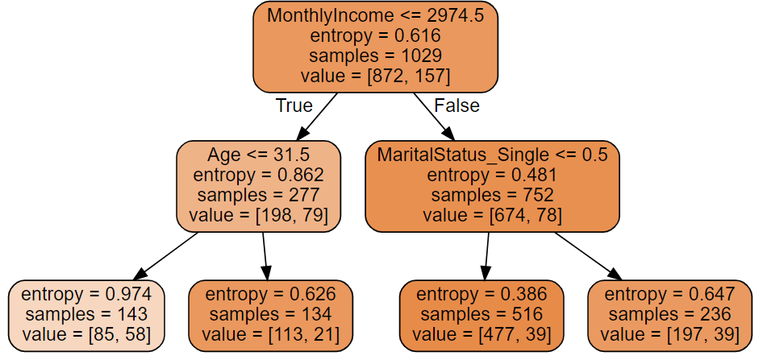
DECISION TREE
Decision Tree is a simple representation for classifying examples. It is a Supervised Machine Learning where the data is continuously split according to a certain parameter.
Decision Tree consists of :
Nodes : Test for the value of a certain attribute.
Edges/ Branch : Correspond to the outcome of a test and connect to the next node or leaf.
Leaf nodes : Terminal nodes that predict the outcome (represent class labels or class distribution).
In the decision tree, the root and internal nodes contain attribute test conditions to separate records that have different characteristics. All the terminal node is assigned a class label Yes or No

Slide 10
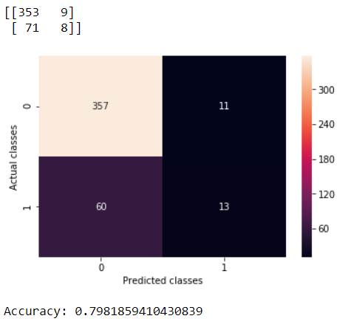
RANDOM FOREST
Random forests or random decision forests are an ensemble learning method for classification, regression and other tasks that operate by constructing a multitude of decision trees at training time and outputting the class that is the mode of the classes (classification) or mean prediction (regression) of the individual trees.
Random forests correct for decision trees' habit of overfitting to their training set.

Slide 11
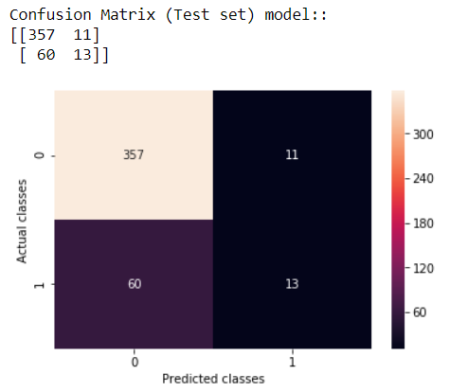
SUPPORT VECTOR MACHINES (SVM)
Supervised learning algorithms try to predict a target (dependent variable) using features (independent variables).
Depending on the characteristics of target variable, it can be a classification (discrete target variable) or a regression (continuous target variable) task. Prediction is done with a mapping function which maps independent variables to dependent variable.
The Kernel we used in our model was ‘Linear’.

Slide 12
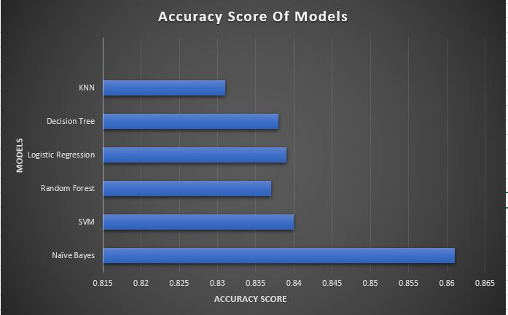
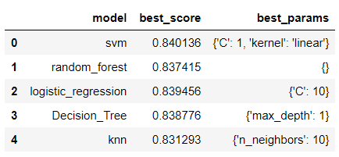

GRID SEARCH CV
Grid search is the process of performing hyper parameter tuning in order to determine the optimal values for a given model.
What are hyperparameters?
Hyperparameters, are the parameters that cannot be directly learned from the regular training process. They are usually fixed before the actual training process begins. These parameters express important properties of the model such as its complexity or how fast it should learn.
Some examples of model hyperparameters include:
The penalty in Logistic Regression Classifier i.e. L1 or L2 regularization
The learning rate for training a neural network.
The C and sigma hyperparameters for support vector machines.
The k in k-nearest neighbors.
5 Naïve Bayes

Slide 13
Conclusion
Of all the models applied on the dataset, grid search CV suggests the best accuracy score of the Gaussian Naïve Bayes classifier.
Even after the hyperparameter tuning of the various models, the best scores of each fell less of the accuracy score of the Naïve Bayes Classifier.
Gaussian Naive Bayes is an algorithm having a Probabilistic Approach. It involves prior and posterior probability calculation of the classes in the dataset and the test data given a class respectively. This makes the classification of data more accurate.
For a dataset to predict attrition rate the posterior probabilities play a very important role, such as the range of the employee age, income, job satisfaction etc. with Naïve Bayes classifier these values are significantly used to find the final probability of attrition.
It performs better in the case of categorical input variables as compared to numerical variables. In the dataset most of the selected variables were categorical.

Slide 14
OTHER APPICATIONS OF GAUSSIAN NAÏVE BAYES
Text classification/ Spam Filtering/ Sentiment Analysis: Naive Bayes classifiers are mostly used in text classification (due to their better results in multi-class problems and independence rule) have a higher success rate as compared to other algorithms. As a result, it is widely used in Spam filtering (identify spam e-mail) and Sentiment Analysis (in social media analysis, to identify positive and negative customer sentiments)
Recommendation System: Naive Bayes Classifier along with algorithms like Collaborative Filtering makes a Recommendation System that uses machine learning and data mining techniques to filter unseen information and predict whether a user would like a given resource or not.

Slide 15
